Slide 1

GWG Holdings, Inc.
The Beneficient Company Group, L.P.
Understanding Secondary Market Solutions
For Informational Purposes Only. For RIA and Broker-Dealer Use Only.
This presentation contains information regarding certain securities offerings. This information does not constitute a solicitation to buy or an offer to sell any securities which can only be made with the applicable offering document.
© 2021 | All Company Data as of September 30, 2020, unless otherwise noted.

Slide 2

Tim Evans
Chief Financial Officer – GWG Holdings, Inc.
Joined GWG Holdings, Inc. as Chief Integration Officer in 2019 and was named Chief Financial Officer in August 2019.
Tim is an attorney and a Certified Public Accountant who served as Chief of Staff and Deputy General Counsel for The Beneficient Company, L.P. before joining GWGH.
Tim served as a trial attorney for the Securities and Exchange Commission (SEC) in its Fort Worth office for six years and in Washington, D.C. was counsel to the director of the agency’s enforcement. Before joining the SEC, Mr. Evans was an associate in the Dallas office of Thompson & Knight LLP for four years.
Tim graduated from the University of Illinois at Urbana-Champaign with a Bachelor of Arts – Economics in 2001 and received his Juris Doctorate, summa cum laude, from the University of Arkansas School of Law in 2008.

Slide 3
Agenda
GWGH Evolution
The Market & Why
Competitive Advantages & Business Model
Power of Partnership and Q&A

Slide 4
Disclaimer
Not an Offer to Sell Securities. The information provided herein does not constitute an offer to sell securities or the solicitation of an offer to buy securities. An offer to sell securities can only be made by a Prospectus, pursuant to a registration statement, and any amendments thereto, then effective and on file with the Securities and Exchange Commission (SEC). Investors must read the entire Prospectus for investment conditions, risk factors, minimum requirements, fees and expenses and other pertinent information with respect to the L Bonds in order to obtain the information essential to making an informed investment decision. No dealer, broker, salesperson, or other person has been authorized by GWGH to give any information or to make any representation other than as contained in the Prospectus, and, if given or made, such other information or representations must not be relied upon as having been authorized by GWGH. No statement found herein is incorporated by reference into the Prospectus, and no statement herein constitutes any part of the Prospectus.
Investment Decisions. This information is not intended to replace any information or consultation provided by a registered representative or other professional. We have filed a registration statement (including prospectus) with the SEC for the offering to which this material relates. Before you invest, you should read the prospectus in the registration statement (including the risk factors described therein) and other documents we have filed with the SEC for more complete information about us and the offering. You may get these documents for free by visiting EDGAR on the SEC website at http://www.sec.gov/. Alternatively, the issuer, any underwriter or any dealer participating in the offering will arrange to send you the prospectus if you request it by calling toll-free 1-877-494-2388.
The estimates, targets and forward-looking statements contained herein may or may not be realized, and differences between estimated results and those realized may be material. Such estimates, targets and forward-looking statements are illustrative purposes only. Accordingly, there can be no assurance that the estimates, targets or forward-looking statements contained herein will be realized or are accurate and complete.
Information is subject to change without notice and may not be updated. GWGH is under no obligation to update any information included herein. The information and expressions of opinions are subject to change without notice and speak only as of the respective dates in which they are made.
Securities are being offered on a best-efforts basis on behalf of GWGH by Emerson Equity LLC, Member FINRA, SIPC, Managing Broker-Dealer for the Issuer. GWGH and Emerson are not affiliated entities.
ISSUER PREPARED MATERIAL
Copyright 2021. GWG Holdings, Inc. All rights reserved.
FOR BROKER-DEALER AND RIA USE ONLY.
Notes:
Before we begin the presentation, it’s important for you to understand the information provided in this webinar does not constitute an offer to sell securities or the solicitation of an offer to buy securities. An offer to sell securities can only be made by a Prospectus. This information is not intended to replace any information or consultation provided by a registered representative or other professional.

Slide 5
Evolution
FOR BROKER-DEALER AND RIA USE ONLY.
Notes:
Let’s take a step back and look at the evolution of GWG and Ben

Slide 6

Transformation Through the Years
2006
Founded
Independent Broker-Dealers
and Registered Investment Advisors
2009
2014
Nasdaq: GWGH
Moving Forward: Growth and Diversity
2021
FOR BROKER-DEALER AND RIA USE ONLY.
Notes:
GWG Holdings has been in business since 2006, initially providing liquidity to individuals owning life insurance policies.
In the beginning, GWG was funded by a large institutional bank but then in 2009 we began to raise our own capital, offering securities to investors through broker-dealers and RIA’s around the country.
In 2014 we listed on Nasdaq and all subsequent offerings have been publically registered securities
This has provided increased transparency for investors with the ability to review our companies quarterly and annual filings.
Beginning in 2018 and finalizing at the end of 2019, GWGH completed a series of transactions with The Beneficient Company Group, L.P.,I will refer to them as BEN moving forward. Which that resulted in a reorientation of our business and capital allocation strategy.
In 2021 we now offer liquidity to a much larger clientele and have greatly increased the assets of the company which again support the Lbond offering.

Slide 7
Portfolio of Assets
Asset Diversification
FOR BROKER-DEALER AND RIA USE ONLY.
Notes:
As you can see, GWG’s stockholder equity is $220 million. Remember, L Bonds holders sits higher on the capital stack then equity holders and stockholder equity is calculated after all the L Bond positions have been satisfied.
So now Let’s take a closer look both major assets classes inside the portfolio that back the L Bonds.

Slide 8
Timeline of 2021 Milestones for GWGH and Ben
January | February | April | May | June | July | August | September
Ben files for eight patents and copyrights on tools for streamlined underwriting, risk management, online submission of asset information, and the ability to provide liquidity pricing quotes | GWGH voluntarily submits questions to the SEC’s Office of Chief Accountant (OCA) Ben partners with London-based Oxford Economics to produce white paper “Maximizing the Opportunity in Private Markets” | Kansas Governor Laura Kelly signs Technology Enabled Fiduciary Financial Institutions (TEFFI) Act into law Ben names Maria Rutledge Chief Technology Officer | Ben establishes Kansas operation to begin the TEFFI pilot Ben expands its Originations team with the hiring of three senior executives for a total of | Ben launches GP Solutions program of liquidity, asset management and structured solutions for general partners | Ben granted a conditional Kansas trust charter GWGH in person Due Diligence meeting held in Dallas Roadshow begins for Ben convertible preferred offerings Ben receives findings from a first-of-its-kind national survey of high-net-worth investors about their illiquid investments | GWGH receives decision from SEC’s OCA GWGH begins restating 2019 earnings GWGH signs credit facility to support liquidity GWGH announces plans to deconsolidate Ben from GWG Holdings | GWGH successfully appeals proposed Nasdaq delisting Ben creates new credit risk portfolio and quantitative analytics team lead by Credit Risk Officer Sam Hikspoors Total number of GWG and Ben employees reaches 157, a rise of 29% since 2019

Slide 9
GWGH Team & Performance
GWGH’s history of private placement and publicly-registered securities
Private
Public
Equity
Debt
GWGH has never missed an interest, dividend, or maturity payment *
More than $2.53 billion raised
since 2009
11 years of bond issuances under one indenture
CURRENT TEAM:
7 territories across the U.S. to support you
2009
LifeNotes
2011
Series A Preferred
2011
Renewable Secured Debentures
2014
Public Company IPO Nasdaq: GWGH
2014
L Bond
2015
Redeemable Preferred Stock
2017
L Bond
(2nd Offering)
2017
Series 2 Redeemable Preferred Stock
2020
L Bond
(3rd Offering)
2020
Ben Liquidity Bond
FOR BROKER-DEALER AND RIA USE ONLY.
Notes:
Over the last 11 years we have raised $2.53B across 9 different public and private offerings.
We have 7 territories across the U.S to support you
To date, GWG has never missed an interest, dividend or maturity payment

Slide 10



Secondary Market Solutions
When it’s needed
When it’s wanted
When it makes financial sense
Life Events
College funding, divorce, retirement, medical needs
Estate Planning
Administrative expense, tax liabilities, division of assets, supplemental strategies
Investment and Business Opportunities
Revised investment allocation, working capital
Notes:
GWG and Ben provides secondary market solutions
Meaning we offer opportunities to individuals and small to medium size institutions that own professionally managed illiquid alternative assets
Unlike large institutions that will hold an illiquid investment to its maturity, individuals and some of these small and medium size institutions often times seek an early exit from these investments as a result of life changes or their need to reallocate their portfolio
There are life events such as: College funding, divorce, retirement, medical needs
Estate Planning events such as: administrative expense, tax liabilities
Or even Investment and Business Opportunity events such as: Revised investment/allocation strategies, or additional working capital a small business owner may need.
Simply put, GWG and BEN seeks to provide early liquidity to alternative asset investors when its wanted, when its needed and when it makes financial sense.

Slide 11
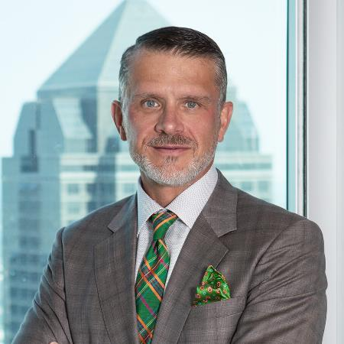
Brad Heppner
Chairman of the Board & Chief Executive Officer
Expertise: 30+ years alternative asset and financial institutions experience
Chairman of the Board and CEO, Ben; Chairman of the Board, GWG Holdings, Inc.; Chairman of the Board, PEN Indemnity Insurance Company, Ltd.
MBA, Kellogg at Northwestern University; BBA, BA, BS, Southern Methodist University
Prior: Founder of The Beneficient Company Group; Founder and CEO of The Crossroads Group (sold to Lehman Brothers and now held by Neuberger Berman); Founder of Capital Analytics (now held by Mitsubishi Union Financial Group); previously with Bain & Company, MacArthur Foundation and Goldman Sachs

Slide 12
GWGH & Ben:
The Market & Why
FOR BROKER-DEALER AND RIA USE ONLY.
Notes:
Let’s spend some time looking at the professionally managed, alternative asset market. We believe strongly that this market is growing and the need for our liquidity serves is greatly needed in an underserved market.

Slide 13
Ben Risk Considerations
Subject to Qualification. To understand the terms of the securities fully, you should carefully read the entire Confidential Private Placement Memorandum and Binding Term Sheet (including the materials incorporated by reference therein, the "Offering Materials") before making a decision to acquire Liquidity Bonds.
GWG Holdings, Inc. ("GWGH") and The Beneficient Company Group, L.P. ("Ben") and their businesses are subject to significant risks and uncertainties which should be carefully considered when reviewing the Materials. The risks and uncertainties described in the Offering Materials are not the only ones we face. Additional risks and uncertainties not presently known may also adversely affect our business. If any of the risks actually occur, our business, financial condition, results of operations and future prospects could be materially and adversely affected.
We do not offer legal, tax, estate or investment advisory services.
These materials do not constitute an offer to sell or the solicitation of an offer to buy securities of GWGH, Ben or any of their or any of its affiliates. Any offer or sale of securities shall be made solely to accredited investors and solely pursuant to the definitive Offering Materials, including definitive subscription materials. Neither GWGH nor The Beneficient Company Group, L.P. (Ben), nor any of their affiliates or representatives, (i) makes any express or implied representation or warranty as to the completeness or accuracy of the information contained in these materials, or (ii) shall have any liability resulting from your use of these materials.
These materials contain certain estimates, projections and forward-looking statements that contain substantial risks and uncertainties. Please see the Offering Materials for a description of risks and uncertainties. The estimates, projections and forward-looking statements contained herein may or may not be realized, accurate or complete, and differences between estimated results and those realized may be material. Such estimates, projections and forward-looking statements are illustrative only and reflect various assumptions of Ben’s management concerning the future performance of Ben and its affiliates, including GWGH and GWG Life, LLC, and are subject to significant business, economic and competitive uncertainties and contingencies, many of which are beyond their control.
The underlying exposure data represents GWG’s exposure to life insurance policies included in its portfolio and GWG’s exposure to the underlying collateral of Ben’s loan portfolio. These Materials contain data concerning interests in alternative assets. The cash flow from these interests underline the senior beneficial interests and beneficial interests that comprise the collateral of Ben’s loan portfolio. The data presented herein does not contain information relating to nonalternative assets (such as common stock and bonds of GWG) and is derived from, among other things, third-party information regarding the net asset value (NAV) of these alternative assets and investments within these alternative assets. Generally, Ben leverages the most recently-received NAV report from each investment manager, which can be adjusted for certain cash and non-cash items including capital calls, distributions, updated material events, and currency valuation adjustments. Ben is not affiliated with, and has no control over, any portfolio investment manager, including with respect to the timing, accuracy and completeness of their reporting of financial and other data. Exposure type reflects classifications based on each company’s portfolio as determined by Ben. "Other Strategy Types” include private debt strategies, natural resources strategies, and hedge funds.
Neither GWGH, Ben, or any of their affiliates, including, GWG Life, LLC or representatives undertakes any obligation or duty to update or revise any of the information contained herein to correct any inaccuracies or to reflect events that occur after the delivery of these materials.
Securities will be offered on a best-efforts basis on behalf of GWGH by Emerson Equity LLC. Member FINRA, SIPC and Managing Broker-Dealer for the issue. GWG Life, LLC, GWGH, Ben and their affiliates, including GWG Life are not affiliated entities of Emerson Equity LLC.
FOR BROKER-DEALER AND RIA USE ONLY.
Notes:
Before we begin, I would like to remind you that The Beneficient Company Group, L.P. (Ben) and its business is subject to significant risks and uncertainties which should be carefully considered when reviewing these materials. The risks and uncertainties described below are not the only ones Ben faces. Additional risks and uncertainties not presently known to Ben may also adversely affect its business. If any of the following risks actually occurs, Ben’s business, financial condition, results of operations and future prospects could be materially and adversely affected. Risks related to Ben include but are not limited to:

Slide 14
Key Investor Drivers and Demand
What are investors seeking in alternative assets?
Risk adjusted investment performance | Reduction of portfolio risk and volatility
Diversification | Professional fund management
Long-term capital appreciation and income generation | Inflation hedge
Lower correlation to other assets
Sources of demand for alternative assets:
Pension funds (public/private) | Sovereign wealth funds | Endowment plans
Financial institutions / wealth managers | Banks | Family offices
Insurance companies | Foundations | Other (mid-to-high net worth individuals and small-to-mid size institutions)

Slide 15
Alternative Assets AUM Growth
$9.1 trillion in alternative assets, growing at ~15% CAGR annually,
2.3x faster than traditional assets
$5.8 trillion held by U.S. investors and institutions, with $1.7 trillion in Ben’s target underserved market
$9.1 trillion
AUM OF BEN’S TARGET MARKET:
$1.5 trillion
Non-U.S. Investors
14.5% CAGR
U.S. MHNW Individual
Investors
U.S. Large Institutional
Investors & Ultra HNW
Individuals
Projected
12/31/2020

Slide 16
Demand for Liquidity Grows as AUM Grows
Global Alternative AUM and Secondary Transactions Correlation
($B)
($B)
($B)
($B)
But Current Secondary Market is Directed Towards Large Investors and Transactions:
16 leading firms have >80% of current market share
Average transaction sizes: $110M to $160M per transaction
r²=.94
Secondary vol growth
correlation to Alt growth
2021P
Global Secondary Transactions
FOR BROKER-DEALER AND RIA USE ONLY.

Slide 17
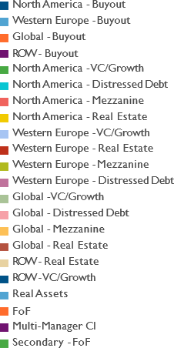
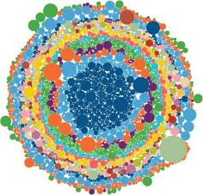

The Alternatives Industry Landscape
Strong Growth in New Managers of Alternative Assets
Alternative Asset Managers: 1998 vs. 2018
1998: Managers in Existence
1,227 Funds | 773 Fund Families
2018: Managers in Existence
9,969 Funds | 6,031 Fund Families
FOR BROKER-DEALER AND RIA USE ONLY.
Notes:
Because of demand, alternative asset managers have grown 1227 funds held by 773 fund families in 1998 to 9969 funds across 6031 fund families, simply trying to meet the demand.

Slide 18































The Alternatives Industry Landscape
Who are the largest players in the alternatives industry?
FOR BROKER-DEALER AND RIA USE ONLY.
Notes:
Here is a snap shot of some of the largest alternative asset fund managers.
Companies like Blackstone, Bridgewater, Apollo and Bain Capital have been creating and managing these funds for both large institutions such as Harvard maybe Yale, even CALPERS. And also small and medium size institutions and even individual investors.
These are the types of funds we look to provide liquidity.

Slide 19
Competitive Advantages & Business Model
The Beneficient Company Group, L.P. (Ben) & GWGH
FOR BROKER-DEALER AND RIA USE ONLY.
Notes:
Now, let’s look at GWG Beneficient’s business model to better understand how and why we manage these assets.

Slide 20
Size of Market Opportunity
U.S. Mid-to-High Net Worth Individuals
$785 BILLION
U.S. Small-to-Mid Size Institutions
$891 BILLION
$40 BILLION growing to $66 BILLION
expected annual demand for liquidity
U.S. Alternative Assets Held by U.S. Investors ($B)
Estimated Annual Demand for Liquidity ($B)
Estimated Annual Demand for Liquidity in 5 Years ($B)
Estimated Annual Turnover Rate
Holdings of
U.S. MHNW
Holdings of
U.S. STMI
Holdings of Large
U.S. Institutions
and Ultra HNW Investors
3.0%
$23
$44
2.0%
+ 5 years
$17
$22
$40 Billion
Underserved, high-growth segment with limited access to intermediated markets for liquidity
$66 Billion
FOR BROKER-DEALER AND RIA USE ONLY.

Slide 21
The J Curve
Internal Rate of Return (IRR) – Net return earned over a particular period of time
Ben provides liquidity at a discount several years into the life cycle of the investment and earns income as the assets make distributions
Targeted Total IRR – 12%
Targeted Ben IRR – 15%
Targeted Investor IRR – 10%
0
2
4
6
8
YEARS
10
12
14
16
18
Sources: Credit Suisse, Preqin
FOR BROKER-DEALER AND RIA USE ONLY.
Notes:
When do we provide liquidity? To best answer that, lets tale a look at the life cycle of an alternative asset fund.
This diagram shows the typical curve that an investment in an alternative asset fund typically takes. Traditionally know as the J-curve.
In the beginning, there is the investment period where individual assets such as buildings, companies, land, etc. is acquired inside the fund. This is represented in the first couple of years.
During the harvest period, these same assets produce income and eventual liquidity until the end of the fund. But if you need liquidity before the end of the fund? Historically there has been few if any options.
Ben’s business model acquires control positions inside these funds but generally later in the life cycle of the fund. Instead of investing in a fund at the beginning, BEN provides liquidity, at a discount, several years into the life cycle of the investment, as indicated in the heavy white line at year 8.
This allows BEN to more accurately underwrite the fund because you have a the ability to see what was already purchased as well as how the fund has historically performed.
So a portfolio may have a targeted return of 12%. An individual or small to medium size institution may need early liquidity in year 8. BEN underwrites those assets and provides a discounted liquidity to the owner. In this example, the owner may have received a 10% annual return on their investment plus then their early liquidity. BEN now acquired control of the revenue stream of the assets with a target return of 15% return moving forward until the contractual end of the fund.

Slide 22
Ben’s Operating Philosophy
Robust risk management guidelines anchor Ben’s originations and underwriting strategies
Areas of Expertise
Technology
Legal and Compliance
Finance, Treasury & Accounting
Trust Administration
Market Capital
Risk Management
Portfolio construction
In-house research and analytics
Centralized financial risk oversight
Underwriting
Alternative asset focus
Fundamental,
bottom-up and technical
top-down analyses
Efficient and effective process to lower execution costs
Originations
Individual investors
Institutions
Wealth managers
General partners
FOR BROKER-DEALER AND RIA USE ONLY.
Notes:
It’s important to note Ben’s operating philosophy centers around robust risk management guidelines that drive origination and underwriting strategies. Risk management drives the allocation strategies of the portfolio and informs the originations team on the types of assets need for growth.

Slide 23


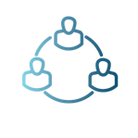






De
Designed to target four principal channels of origination with bespoke strategies and offerings
Direct-to-Investor Channel
Direct investor access through Ben’s secure online client portal
General Partner Solutions Channel
Preferred liquidity provider program
GP carry liquidity
GP structured growth transactions
AltQuote
TrustBen.com
MHNW
Individuals
General Partners
RIAs/ Wealth
Managers
STMIs
Preferred Provider Channel
Strategic, enterprise engagements:
Consultants/ Wirehouses
Advisors/ Intermediaries
Advisory Channel
National, dedicated coverage model supporting
Wealth management firms including registered investment advisors, broker-dealers, private banks
Sponsor firms
AI platform and service providers
Investment consultants
MHNW individual investors
Family offices
Institutional investors
Professional service providers
Secondary advisory and marketplace service providers
Insurance companies
FOR FINANCIAL PROFESSIONAL, RIA AND ACCREDITED INVESTOR USE ONLY
20

Slide 24

Ben’s Competitive Strengths
First mover
Permanent balance sheet capital
Multiple owned channels of origination
Proprietary technologies
Unique charter structure
Culture
Simple, rapid and cost-effective customer experience
Flexible and tax-efficient product portfolio
Leadership
FOR FINANCIAL PROFESSIONAL, RIA AND ACCREDITED INVESTOR USE ONLY

Slide 25
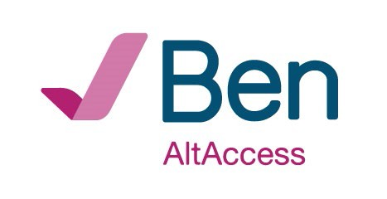









Copyright covering software code for Ben's proprietary digital experience for providing investors the online means to gain liquidity from their alternative assets, supported by the following unique, provisional patent-pending tools and capabilities:
Statistical algorithms intended to provide fast, reliable indications of potential liquidity options for holders of alternative assets
Data-driven statistical algorithms forecasting alternative asset growth and cashflows
Portfolio optimization algorithms specialized for alternative assets
Algorithm creating a consolidated, single metric for monitoring portfolio concentration
Algorithms producing risk- adjusted alternative asset quality score
Algorithms helping assess the fair value to customers that Ben could offer for liquidity solutions
Credit rating algorithm for loans collateralized by alternative assets
Portfolio Management Backbone of AltAccess Underwriting Evaluation Tools for AltAccess
Ben’s transaction and trust structure used to finance the delivery of seamless and cost-effective liquidity to customers, empowering our customers with optionality to meet their specific liquidity needs.
FOR FINANCIAL PROFESSIONAL, RIA AND ACCREDITED INVESTOR USE ONLY
17

Slide 26
Technology Enabled Fiduciary Financial Institutions (TEFFI) Act
First-of-Its-Kind Regulatory Framework for the Industry
Provides a comprehensive regulatory framework for firms that provide liquidity for alternative assets
As the designated pilot for the Kansas TEFFI Act, Ben is partnering with legislators, regulators, and industry stakeholders to ensure a smooth rollout of the new legislation ahead of wider adoption.
Allows general partners, sponsors, custodians, transfer agents and managers to better serve a growing pool of alternative asset investors and for trust banks who finance alternative asset holdings
Kansas State Banking Commissioner to issue a conditional trust banking charter to Ben on July 1, 2021
FOR BROKER-DEALER AND RIA USE ONLY.
Notes:
Provides a comprehensive regulatory framework for firms that provide liquidity for alternative assets
As the designated pilot for the Kansas TEFFI Act, Ben is partnering with legislators, regulators, and industry stakeholders to ensure a smooth rollout of the new legislation ahead of wider adoption.
Allows general partners, sponsors, custodians, transfer agents and managers to better serve a growing pool of alternative asset investors and for trust banks who finance alternative asset holdings
Kansas State Banking Commissioner to issue a conditional trust banking charter to Ben on July 1, 2021

Slide 27
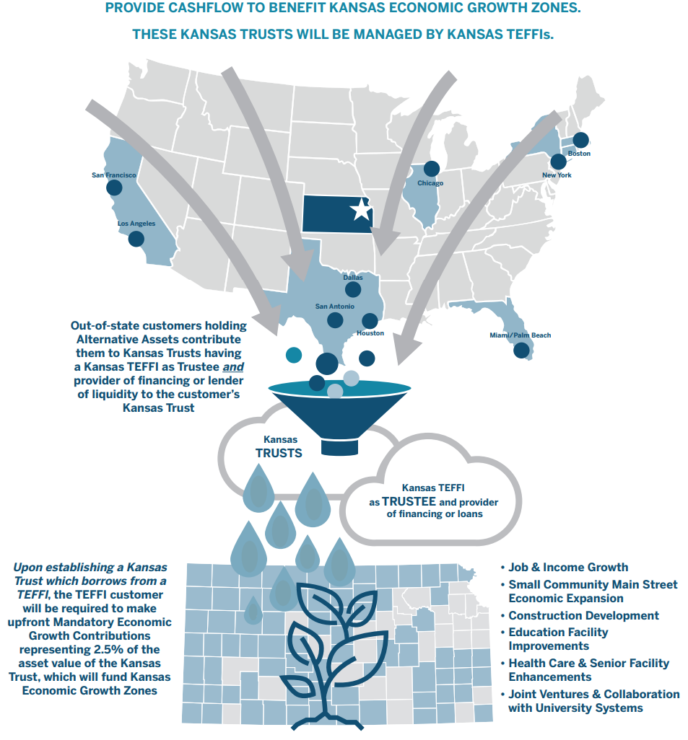
How It Works
PROVIDE CASHFLOW TO BENEFIT KANSAS ECONIMIC GROWTH ZONES
THESE KANSAS TRUSTS WILL BE MANAGED BY KANSAS TEFFIs
Companies who provide liquidity for alternative assets will have the ability to operate efficiently and effectively as a public or private company within the U.S., while also benefitting communities throughout Kansas.
Requires trusts to be established in Kansas to hold alternative assets for investors from across the country and for a Kansas TEFFI trust bank to provide financing to the trusts
So long as those trusts are established and the financings are provided, then economic benefits will flow to those local Kansas communities.
FOR BROKER-DEALER AND RIA USE ONLY.
Notes:
Companies who provide liquidity for alternative assets will have the ability to operate efficiently and effectively as a public or private company within the U.S., while also benefitting communities throughout Kansas.
Requires trusts to be established in Kansas to hold alternative assets for investors from across the country and for a Kansas TEFFI trust bank to provide financing to the trusts
So long as those trusts are established and the financings are provided, then economic benefits will flow to those local Kansas communities.

Slide 28
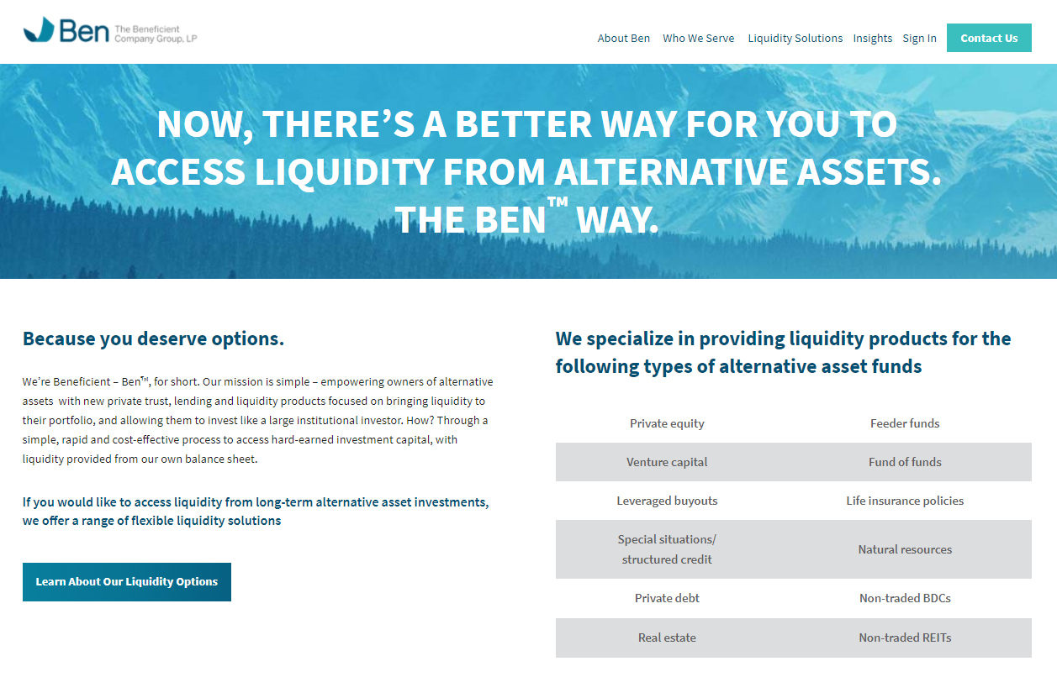
Learn More About Ben…
Trustben.com
FOR BROKER-DEALER AND RIA USE ONLY.
Notes:
To learn more about the leadership of Ben and the Ben business model, I highly encourage you to visit
www.trustben.com

Slide 29
Summary and Your GWG Partners
FOR BROKER-DEALER AND RIA USE ONLY.
Notes:
Now, let’s look at GWG Beneficient’s business model to better understand how and why we manage these assets.

Slide 30
GWGH Team & Performance
GWGH’s history of private placement and publicly-registered securities
Private
Public
Equity
Debt
GWGH has never missed an interest, dividend, or maturity payment *
More than $2.53 billion raised
since 2009
11 years of bond issuances under one indenture
CURRENT TEAM:
7 territories across the U.S. to support you
2009
LifeNotes
2011
Series A Preferred
2011
Renewable Secured Debentures
2014
Public Company IPO Nasdaq: GWGH
2014
L Bond
2015
Redeemable Preferred Stock
2017
L Bond
(2nd Offering)
2017
Series 2 Redeemable Preferred Stock
2020
L Bond
(3rd Offering)
2020
Ben Liquidity Bond
FOR BROKER-DEALER AND RIA USE ONLY.
Notes:
Over the last 11 years we have raised $2.53B across 9 different public and private offerings.
We have 7 territories across the U.S to support you
To date, GWG has never missed an interest, dividend or maturity payment

Slide 31
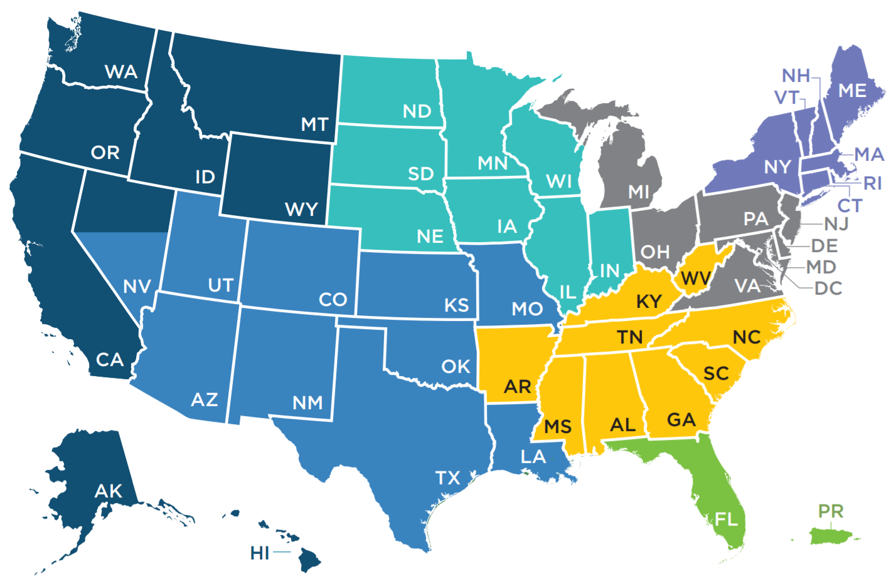
Territory Map
West
Alaska, California, Hawaii, Idaho, Montana, Northern Nevada, Oregon, Washington & Wyoming
STEVEN E. REED
Senior Vice President
m: 612.300.3011
sreed@gwgh.com
REGGIE CABRAL
Regional Sales Associate
d: 612.746.6118 m: 612.380.8376
rcabral@gwgh.com
Mountain Central
Arizona, Colorado, Kansas, Louisiana, Missouri, New Mexico, Oklahoma, Southern Nevada, Texas & Utah
SCOTT BLACKMAN
Senior Vice President
m: 612.802.5770
sblackman@gwgh.com
MICHAEL VICKMAN
Regional Sales Associate
d: 612.746.1934 m: 612.393.5129
mvickman@gwgh.com
North Central
Iowa, Illinois, Indiana, Minnesota, Nebraska, North Dakota, South Dakota & Wisconsin
BRON URBANICK
Regional Vice President
m: 612.475.0563
burbanick@gwgh.com
BEN DILLON
Regional Vice President
d: 612.746.1949 m: 612.802.8766
bdillon@gwgh.com
Northeast
Connecticut, Maine, Massachusetts, New Hampshire, New York, Rhode Island & Vermont
TED BREEN
Regional Vice President
m: 612.475.6376
tbreen@gwgh.com
GREGORY FALZONE
Regional Sales Associate
d: 612.746.6124 m: 612.475.6878
gfalzone@gwgh.com
Mid-Atlantic
Delaware, District of Columbia, Maryland, Michigan, New Jersey, Ohio, Pennsylvania & Virginia
National Accounts & Sales Management
RAYMOND DES ROSIERS
Regional Vice President
m: 612.309.8877
rdesrosiers@gwgh.com
BLAKE ZEGARELLI
Regional Sales Associate
d: 651.314.3120 m: 612.422.1500
bzegarelli@gwgh.com
MERRIAH HARKINS
EVP, Retail Capital Markets
m: 612.999.3359 | mharkins@gwgh.com
MICHELE DRUMMOND
VP, National Accounts
m: 469.755.4777
mdrummond@gwgh.com
PETER ANDERSON
VP, Sales & Bus. Development
d: 612.746.6127 m: 612.516.9119 panderson@gwgh.com
MATTHEW PAINE
SVP, Sales & Training
d: 612.746.1931 m: 612.594.4485 mpaine@gwgh.com
JENNIFFER A. DAIGLE
SVP, National Accounts
m: 612.619.3894 | jdaigle@gwgh.com
KYLA HOPPE
AVP, National Accounts
m: 612.469.3694 | khoppe@gwgh.com
CHRISTINA MIRANDA
VP, Due Diligence
m: 612.839.8977 | cmiranda@gwgh.com
Southeast
Alabama, Arkansas, Georgia, Kentucky, Mississippi, North Carolina, South Carolina, Tennessee & West Virginia
DYLAN WHITE
Regional Vice President
m: 612.475.6530
dwhite@gwgh.com
THEO HALBARDIER
Regional Sales Associate
d: 612.524.5570 m: 612.244.4896
thalbardier@gwgh.com
Florida
Florida & Puerto Rico
DYLAN WHITE
Regional Vice President
m: 612.475.6530
dwhite@gwgh.com
TYLER INGRAM
Regional Sales Associate
d: 612.746.6123 m: 612.961.7664
tingram@gwgh.com

Slide 32
Contact Information
Sales Team
Scott Blackman
Regional Senior Vice President
sblackman@gwgh.com
(612) 802-5770 MOBILE
GWG Holdings, Inc. | 325 North Saint Paul Street, Suite 2650, Dallas, TX 75201
FOR BROKER-DEALER AND RIA USE ONLY.

